Slide 1

How to Build Your Career in AI & ML
Youssef Hosni

Slide 2



Agenda
Three Steps to Start Your Career
Learning
Essential Skills
Where to Learn?
Developing Learning Habits?
Building Projects
Approaching AI Projects
Building Portfolio Projects
Land a Job
How to Land a Job?
Keys to Building Successful Career
Final Thoughts
Overcoming Imposter Syndrome
Make Everyday Count

Slide 3

AI is the new electricity. It will transform and improve all areas of human life
Andrew NG – Founder of Deep Learning.ai

Slide 4

Three Steps to Start Your Career

Slide 5



Three Steps to Start Your Career
Learning: Initially, you focus on learning foundational skills.
Projects: After having gained foundational technical skills, you will begin working on projects. During this period, you’ll also keep learning.
Job Searching: Later, you will work on finding a job. Throughout this process, you’ll continue to learn and work on meaningful projects.

Slide 6
Three Steps to Start Your Career
Learning foundational skills is a career-long process
Working on projects often means collaborating with stakeholders who lack expertise in AI
Inconsistent opinions on AI skills and jobs roles

Slide 7

Learning

Slide 8





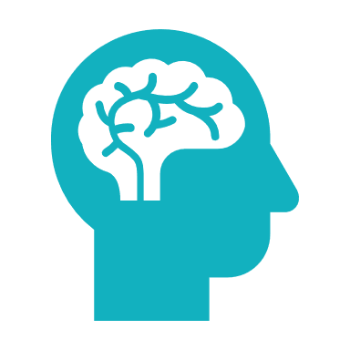

Essential Skills
Software Development
Mathematics
Data Related Skills
Foundational Machine Learning Models
How Machine Learning Models Work
Deep Learning
Practical Machine Learning

Slide 9

Software Development
While you can get a job and make huge contributions with only machine learning modelling skills, your job opportunities will increase if you can also write good software to implement complex AI systems.
These skills include:
Programming fundamentals
Data structures (especially those that relate to machine learning, such as data frames)
Algorithms (including those related to databases and data manipulation),
Software design
Python key libraries such as TensorFlow or Pytorch, Scikit-learn, Numpy and Pandas.
My recommendation:
Python for Everyone Specialization
Software engineering for data scientist

Slide 10

Mathematics
Mathematics are the foundation of machine learning and deep learning algorithms, so it is important to have strong mathematical background in theses areas:
Linear algebra (vectors, matrices, and various manipulations of them)
Probability and statistics (including discrete and continuous probability, standard probability distributions, basic rules such as independence and Bayes’ rule, and hypothesis testing).
Basic intuitive understanding of calculus
In addition, exploratory data analysis (EDA) — using visualizations and other methods to systematically explore a dataset — is an underrated skill.
The math needed to do machine learning well has been changing. For instance, although some tasks require calculus, improved automatic differentiation software makes it possible to invent and implement new neural network architectures without doing any calculus. This was almost impossible a decade ago.
My recommendation: Mathematics for Machine Learning

Slide 11

Data Related Skills
Since you will be working with data, it is important to be able to have hands on skills on using the data effectively for your models. This includes:
Data collection
Data cleaning
Data exploration
Feature engineering
My recommendation: Google Data Analytics Professional Certificate

Slide 12

Foundational Machine Learning Models
it’s important to have very good understanding for basic models machine learning models such as linear regression, logistic regression, neural networks, decision trees, clustering, and anomaly detection.
My recommendation: Machine Learning Specialization

Slide 13

How Machine Learning Models Work
Beyond specific models, it’s even more important to understand the core concepts behind how and why machine learning works, such as bias/variance, cost functions, regularization, optimization algorithms, and error analysis.
My recommendation: Machine Learning Specialization

Slide 14

Deep Learning
Deep learning became such a large fraction of machine learning that it’s hard to excel in the field without some understanding of it! It’s valuable to know the basics of neural networks, practical skills for making them work (such as hyperparameter tuning), convolutional networks, sequence models, and transformers.
My recommendation:
Deep Learning Specialization
TensorFlow Developer Professional Certificate

Slide 15

Practical Machine Learning
It is become more important to deploy the models into production and monitor them after that.
My recommendation:
Machine Learning Engineering for Production (MLOps) Specialization
Practical Data Science on the AWS Cloud Specialization

Slide 16
From Where To Learn?
There’s a lot of good content on the internet, and in theory, they could work. But when the goal is deep understanding, they will be inefficient because they tend to repeat each other, use inconsistent terminology (which slows you down), vary in quality, and leave gaps.
That’s why a good course in which a body of material has been organized into a coherent and logical form is often the most time-efficient way to master a meaningful body of knowledge. My recommendation is:
Solid textbooks
Coursera & Udacity
University open courses
When you’ve absorbed the knowledge available in courses, you can switch over to research papers and more advanced resources.

Slide 17
Developing Learning Habits
Given how quickly our field is changing, there’s little choice but to keep learning if you want to keep up.
Developing a daily learning habit is a must to be able to keep up with the advances in the filed.
More Information read:
Atomic Habits
Tiny Habits

Slide 18
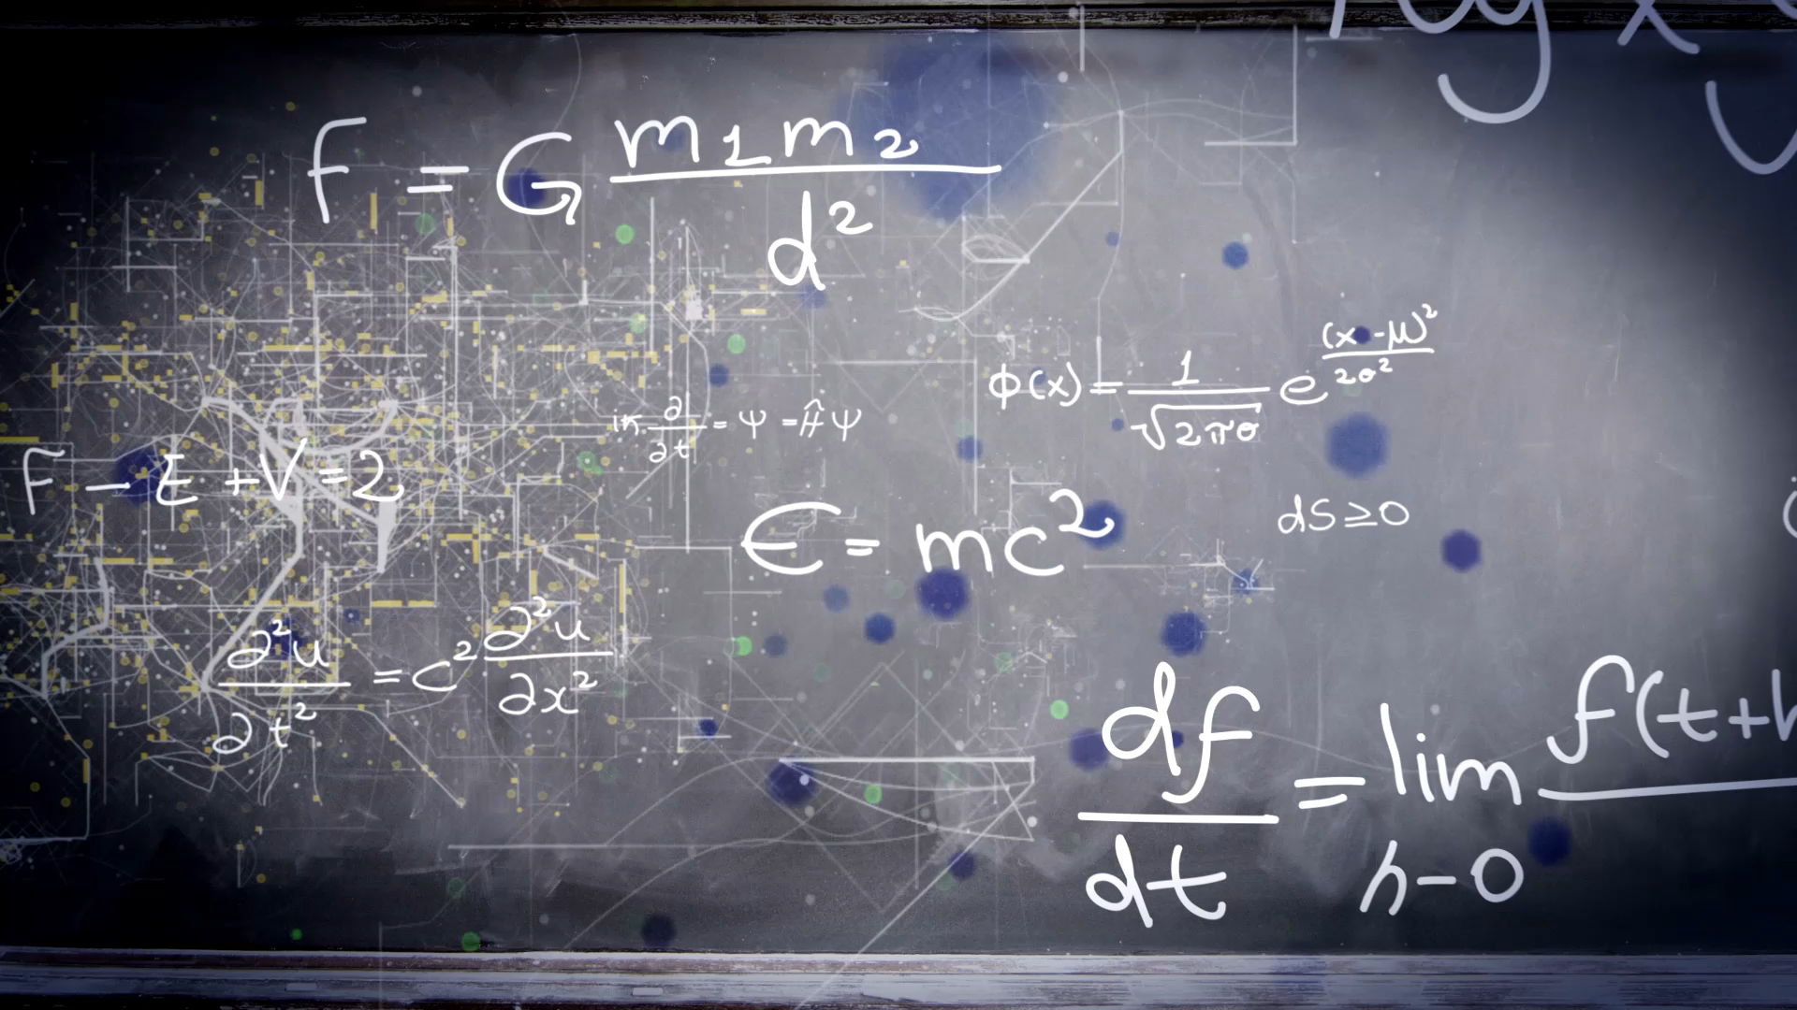
Building Projects

Slide 19
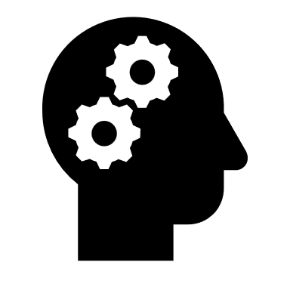
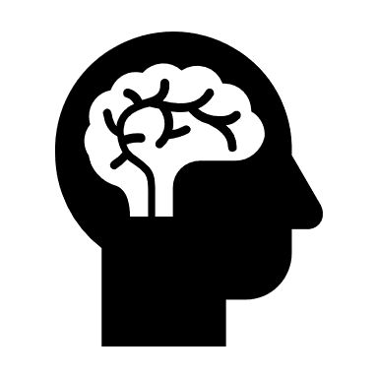




Approaching AI Projects
Identify a business problem (not an AI problem)
Brainstorm AI solutions
Assess the feasibility and value of potential solutions.
Determine Success metrics.
Budget for resources
Iterate

Slide 20

Identify A Business Problem
The first step is to identify a business problem. You can ask a domain expert and ask, “What are the top three things that you wish worked better? Why aren’t they working yet?”
You can search the case studies that companies are working on right now.

Slide 21

Brainstorm AI solutions
Once you understand a problem, you can brainstorm potential solutions more efficiently.
Sometimes there isn’t a good AI solution, and that’s okay too

Slide 22

Assess Feasibility & Values
You can determine whether an approach is technically feasible by looking at:
Published work
Competitors work & results
Perhaps building a quick proof of concept implementation.
Consulting with domain experts.

Slide 23

Determine Success Metrics
Once you’ve deemed a project sufficiently valuable, the next step is to determine the metrics to aim for. This includes both machine learning metrics (such as accuracy) and business metrics (such as revenue).

Slide 24

Budget For Resources
Think through everything you’ll need to get the project done including data, personnel, time, and any integrations or support you may need from other teams.

Slide 25

Iterate
Working on projects is an iterative process. If, at any step, you find that the current direction is infeasible, return to an earlier step and proceed with your new understanding.

Slide 26
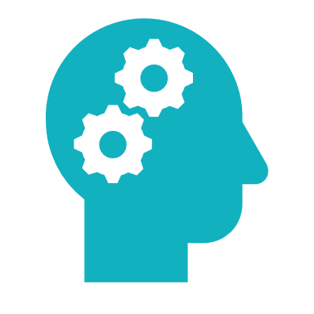


Build Portfolio of Projects
Skill Based Projects
Class Projects
End to end projects

Slide 27
End to End Projects
Select
Select a domain of interest
Define
Define important case studies
Select
Select one case study
Collect
Collect data
Make
Make it end to end
Publish & talk about
Publish & talk about it

Slide 28
Building a portfolio of projects, especially one that shows progress over time from simple to complex undertakings, will be a big help when it comes to looking for a job.
Andrew NG

Slide 29

Land a Job

Slide 30




How to Land a Job?
Pay attention to the basics
Connect
Proceed respectfully and responsibly
Choose who to work with
Get help from your community

Slide 31




Keys to Building Successful Career
Teamwork
Communication
Networking
Personal discipline
Altruism

Slide 32

Final Thoughts

Slide 33
Overcoming Imposter Syndrome
AI is technically complex, and it has its fair share of smart and highly capable people. But it is easy to forget that to become good at anything, the first step is to suck at it.
Have supportive mentors or peers
No one is an expert at everything

Slide 34

Make Everyday Count
How many weeks is is a typical human lifespan?
How many days is a typical human lifespan?
How many hours is a typical is a typical human lifespan?

Slide 35
إنما الأعمال بالنيات وإنما لكل امرئ ما نوى فمن كانت هجرته إلى الله ورسوله فهجرته إلى الله ورسوله ومن كانت هجرته لدنيا يصيبها أو امرأة ينكحها فهجرته إلى ما هاجر إليه

Slide 36


Thank You
Youssef Hosni
Youssef.Hosni95@outlook.com
LinkedIn

